Slide 1

P_update
Format: b0 v0 chi_max
Need to see collapse of dilute layer to get sharp decrease

Slide 2




Corrected
Previous

Slide 3

Incorrect

Slide 4

Corrected - 20220722

Slide 5
Fine adjust

Slide 6












b1.0 v0.51 c6
b1.0 v0.52 c6
b=1.0, v=0.50, chi = 2.4, 2.6, 2.8

Slide 7







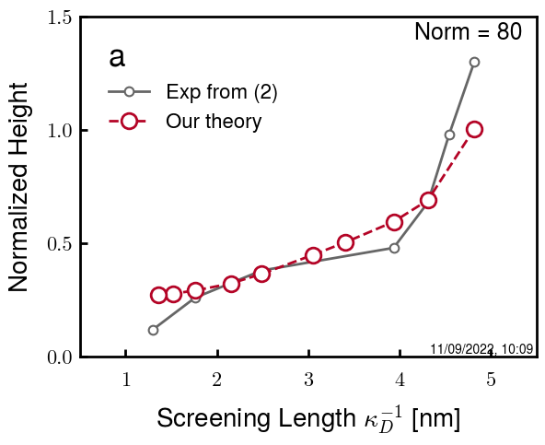
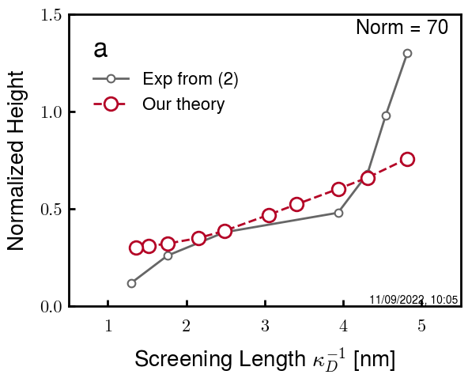
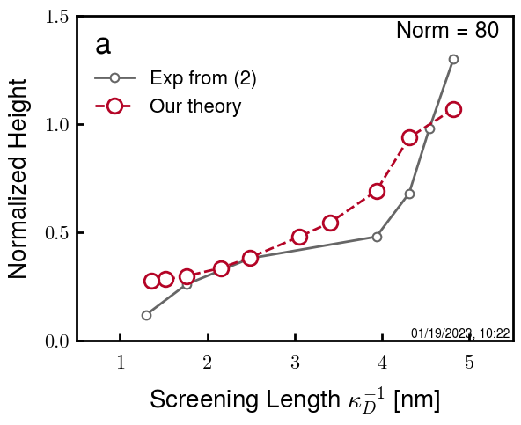
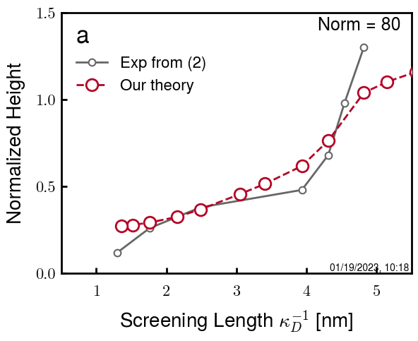
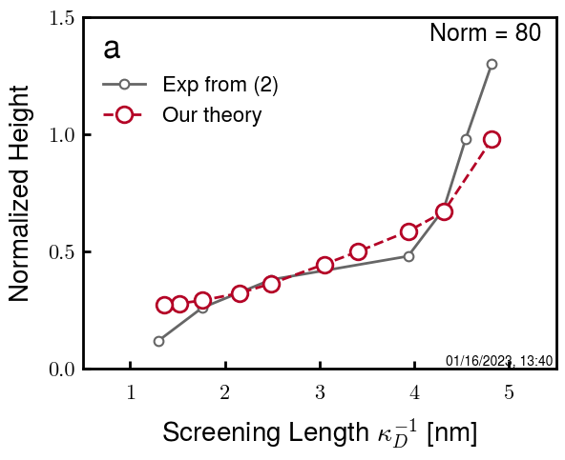
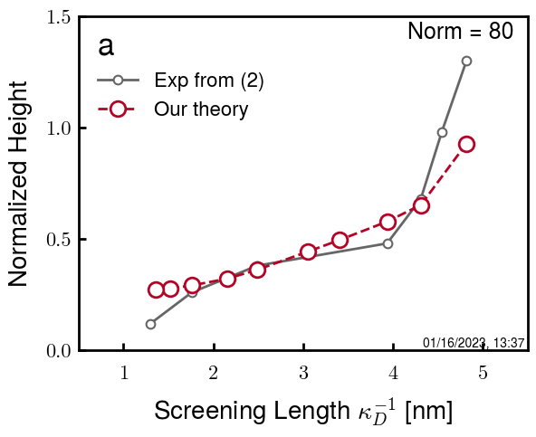
b=2.0, v=1.20, chi = 2.4, 2.6, 2.8
b2.0 v1.20 c8
b2.0 v1.21 c8
b2.1 v1.20 c8
b2.2 v1.22 c8
b2.2 v1.22 c0
b2.2 v1.22 c1
b2.2 v1.22 c2
b2.2 v1.20 c3.05
b2.2 v1.20 c1
b2.2 v1.22 c1
b2.2 v1.23 c1
b2.2 v1.24 c1

Slide 8
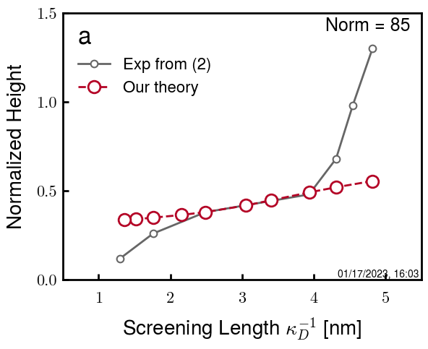
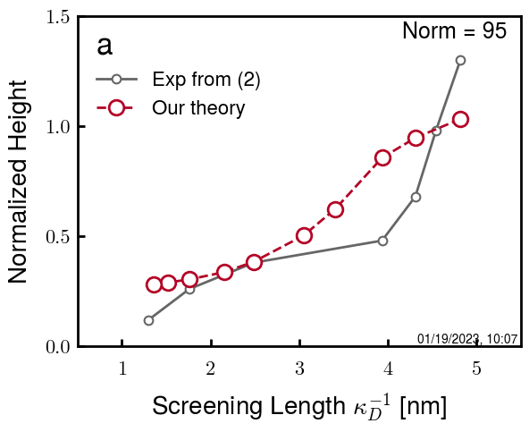

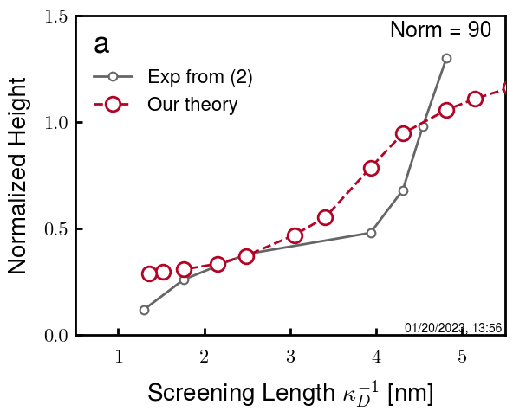
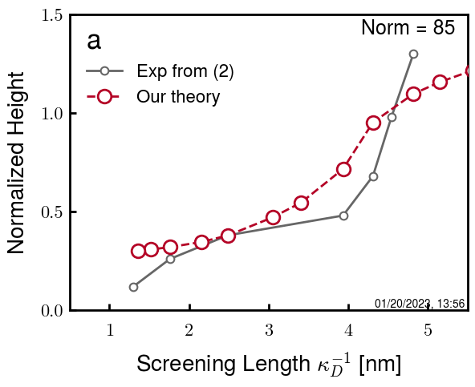
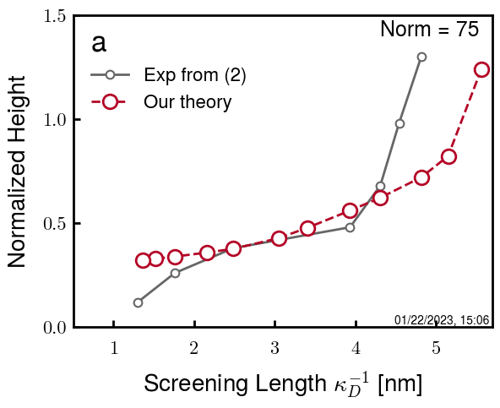
b2.5 v1.25 c3.10
b2.5 v1.25 c3.15
b2.5 v1.25 c3.20
b2.5 v1.25 c3.25 (f255)
b2.5 v1.25 c3.30 (f253)
b2.5 v1.25 c3.32 (f332)
b2.5 v1.25 c3.35 (f335)
Chi block 5 wrong

Slide 9
Summary

Slide 10
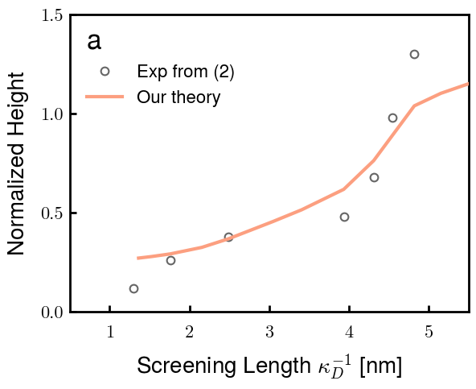
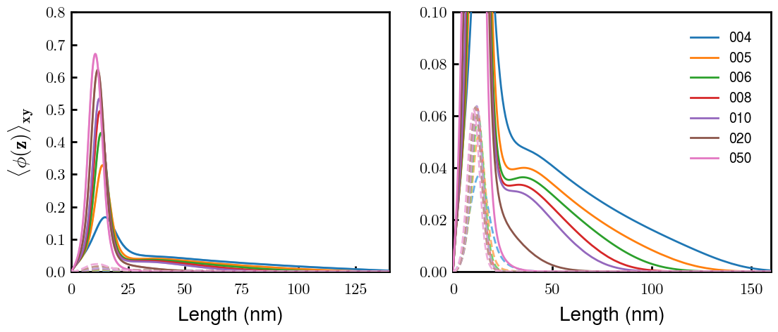

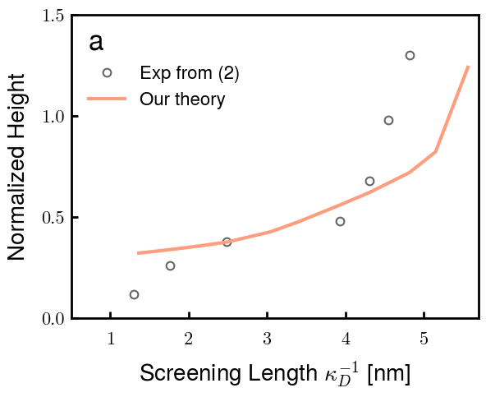
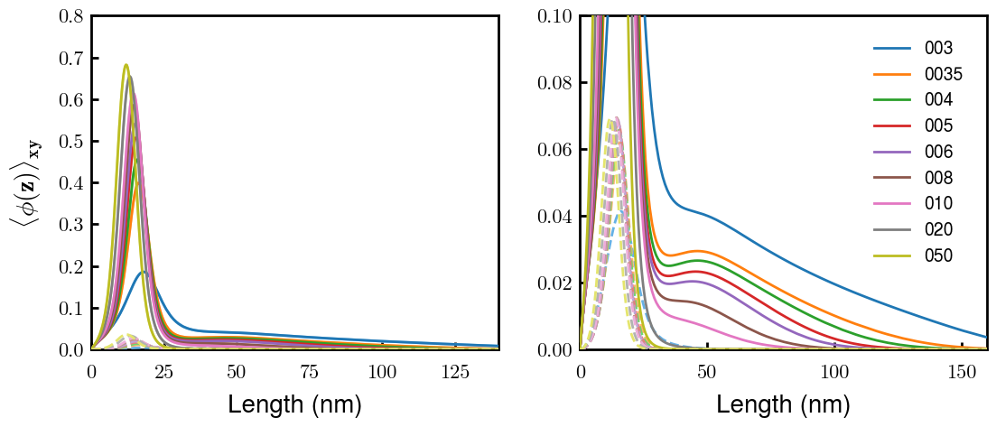
Best so far:
b2.2 v1.20 c3.10 (f201)
b2.5 v1.25 c3.35 (f335)

Slide 11
Interacting
NFH on both plates with decreasing centerline distance D

Slide 12
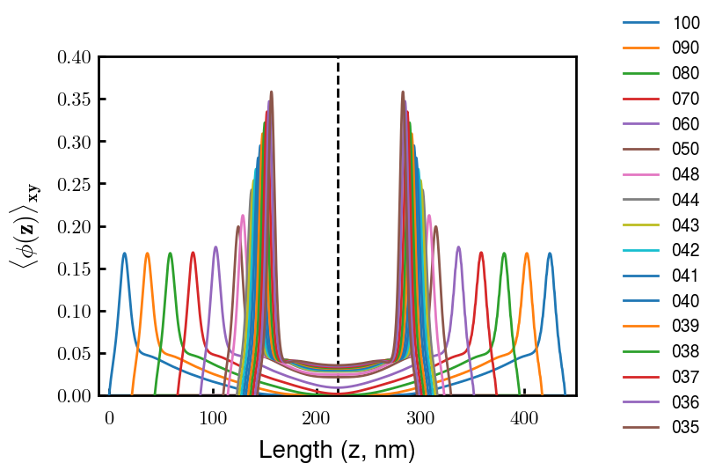
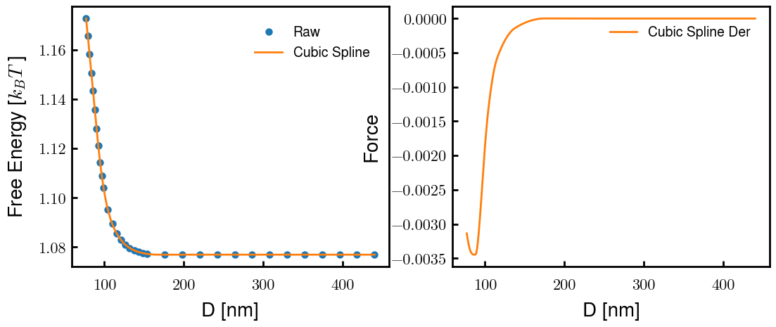
Sample for b2.2 v1.20 c3.1
Cs = 4mM
Labels are z/b0

Slide 13
Initial sweep
b10, b15, b20; chi 2.6
v0 = x b^3 (b/d ratio)

Slide 14

Using excluded volume from Rubinstein Ch 3.1
Start with b = 0.5, 1.0, 1.5, 2.0, 5.0 nm
V0 = b^3 (spherical) (max flexible)
b^2 * d (cylindrical)
New options (09/03 code)
V0 = 4/3*pi*b^3 (b/d = 0.2387…) (Max flexible)
V1 = 1.00*b^3 (b/d = 1.0)
V2 = 0.50*b^3 (b/d = 2.0) (Rubinstein “flexible”)
V3 = 0.33*b^3 (b/d = 3.0) (Rubinstein “flexible”)
V4 = 0.15*b^3 (b/d = 6.5)
Rubinstein, pdf pg 108: b/d 2~3 for flexible,
PE, PEO: d = 0.8 nm
PS: d = 0.5 nm

Slide 15





b10 – thresh = 1e-04

Slide 16




b10 – maxpoint Gibbs

Slide 17




b10 – first moment Gibbs

Slide 18





b10

Slide 19





B15 – thresh = 1e-04

Slide 20





b15 - maxpt

Slide 21





b15 - norm

Slide 22





b15

Slide 23





b20 – thresh = 1e-04

Slide 24





b20 - maxpt

Slide 25




b20 - norm

Slide 26





b20

Slide 27
V perturb
Around b10 v2 and b20 v4 (~%20)

Slide 28






-20%: v=0.4
Orig: b=1.0, v=0.5
+20%: v=0.6

Slide 29



-20%: v=0.4
Orig: b=1.0, v=0.5
+20%: v=0.6

Slide 30






-20%: v=1.0
Orig: b=2.0, v=1.2
+20%: v=1.4

Slide 31


-20%: v=1.0
Orig: b=2.0, v=1.2
+20%: v=1.4

Slide 32
Chi perturb
Around b10 v2 and b20 v4 (~%20)

Slide 33





c4
Orig: b=1.0, v=0.5, chi = 2.6
c8
c0

Slide 34



c4
Orig: b=1.0, v=0.5, chi = 2.6
c8
c0

Slide 35







c4
Orig: b=2.0, v=1.2, chi = 2.6
c8
c0

Slide 36



c4
Orig: b=2.0, v=1.2, chi = 2.6
c8
c0

Slide 37
PREV

Slide 38






06 04 260
06 04 240
06 04 220
07 04 260
07 04 240
07 04 220

Slide 39






08 04 260
08 04 240
08 04 220
09 04 260
09 04 240
09 04 220

Slide 40
10 04 260
10 04 240
10 04 220
All stretched longer than given box size (150*0.6 = 90)

Slide 41






04 03 260
04 03 240
04 03 220
05 03 260
05 03 240
05 03 220

Slide 42






06 03 260
06 03 240
06 03 220
07 03 260
07 03 240
07 03 220

Slide 43





04 05 260
04 05 240
04 05 220
05 05 260
05 05 240
05 05 220

Slide 44






06 05 260
06 05 240
06 05 220
07 05 260
07 05 240
07 05 220

Slide 45




04 06 260
04 06 240
04 06 220
05 06 260
05 06 240
05 06 220

Slide 46






06 06 260
06 06 240
06 06 220
07 06 260
07 06 240
07 06 220

Slide 47



05 07 260
05 07 240
05 07 220
06 07 260
06 07 240
06 07 220

Slide 48



07 07 260
07 07 240
07 07 220
08 07 260
08 07 240
08 07 220

Slide 49
06 09 260
06 09 240
06 09 220
07 09 260
07 09 240
07 09 220

Slide 50





08 09 260
08 09 240
08 09 220
09 09 260
09 09 240
09 09 220

Slide 51



10 09 260
10 09 240
10 09 220

Slide 52






1.0 1.0 2.6
1.0 1.0 2.8
1.0 1.0 3.0
1.2 1.0 2.6
1.2 1.0 2.8
1.2 1.0 3.0

Slide 53




1.4 1.0 2.6
1.4 1.0 2.8
1.4 1.0 3.0
1.0 1.2 2.6
1.0 1.2 2.8
1.0 1.2 3.0

Slide 54




1.2 1.2 2.6
1.2 1.2 2.8
1.2 1.2 3.0
1.4 1.2 2.6
1.4 1.2 2.8
1.4 1.2 3.0

Slide 55






1.0 1.4 2.6
1.0 1.4 2.8
1.0 1.4 3.0
1.2 1.4 2.6
1.2 1.4 2.8
1.2 1.4 3.0

Slide 56

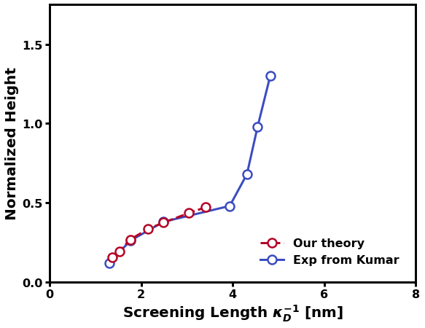

1.4 1.4 2.6
1.4 1.4 2.8
1.4 1.4 3.0

